Slide 1
Knowledge Representation
INT404

Slide 2
Knowledge Representation
Earlier it was believed that the best approach to solutions was through the development of General Purpose Problem Solver, that is, systems powerful to prove a theorem in geometry, perform a complex robotic task, or to develop a plan to complete a sequence of operations.
But it was deduced that the systems became effective only when the solution methods incorporated domain specific rules and facts, i.e. after gaining specific knowledge.
It eventually led to knowledge based systems.

Slide 3
Knowledge Representation
Importance of Knowledge
  Knowledge can be defined as the body of facts and principles accumulated by human-kind or the act, fact or state of knowing.
  In actuality it is more than this, it also includes having a familiarity with language, concepts, procedures, rules, ideas, abstractions , places, customs, facts associations along with ability to use these notions effectively in modeling different aspects of the world.
How is knowledge stored in biological organisms and computers?
  Human brain weighs 3.3 pounds - estimated number of neurons 10¹² - potential storage – 10¹⁴
  In computers, knowledge is also stored as symbolic structures, in the form of collections of magnetic spots and voltage states.

Slide 4
Knowledge Representation
Let’s take the following examples
  A is tall.
  A Loves B. ☺
  C has learned to use recursion to manipulate linked lists in several programming languages.
  1st one represents a fact, an attribute possessed by a person.
  2nd expresses a complex binary relation between two persons.
  3rd is most complex, expressing relations between a person and more abstract programming concepts.

Slide 5
Knowledge Representation
Knowledge can be of following types
  Declarative (statements)
  Procedural (facts,rules,function)
  Heuristics (rule of thumb / experience)
We should not confuse Knowledge with data.
– Physician example
Belief v/s Hypothesis
  Belief is any meaningful and coherent expression that can be represented.
  Hypothesis is a justified belief that is not known to be true.
Epistemology – study of nature of knowledge.
Metaknowldge – knowledge about knowledge.

Slide 6
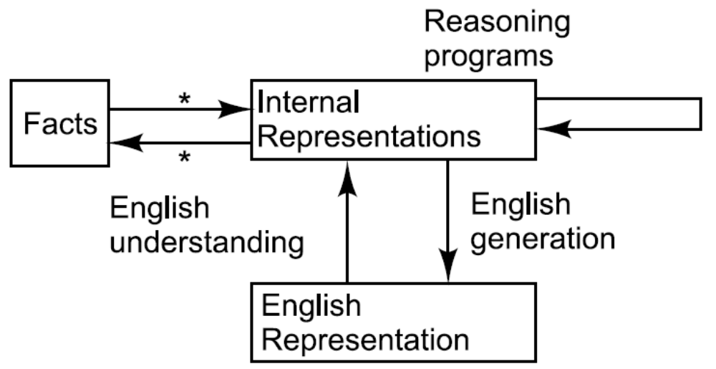
Mappings between Facts and Representation
Facts: Truths in some relevant world. These are the things we want to represent
Representation of fact in some chosen formalism. These are the things we will actually
be able to manipulate

Slide 7
Knowledge Representation
Some mathematical ways of representing the representing sentences
  Spot is a dog. → dog(spot)
  All dogs have tails. → Vx : dog(x) → hastail(x)
  Then using the deduction method of logic, we may generate they new representation object : hastail(spot)
  So we can , using backward mapping function : Spot has a tail.

Slide 8
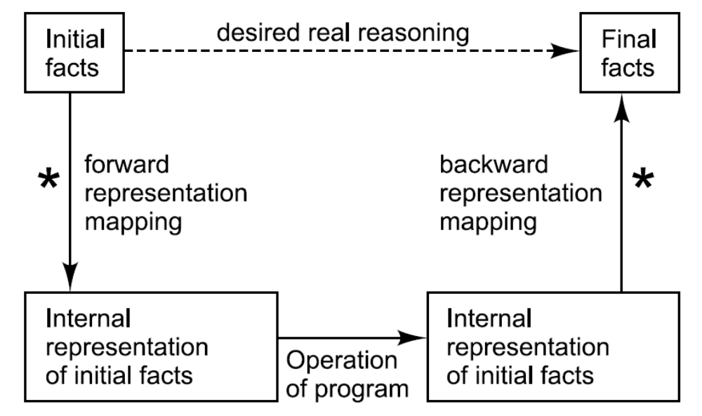
Representation of Facts

Slide 9
Knowledge Representation
Approaches to Knowledge representation
A good system for the representation of knowledge in a particular domain should possess the following properties :
  Representational Adequacy – the ability to represent all of the kinds of knowledge that are needed in that domain
    Inferential Adequacy – The ability to manipulate the representational structures in such a way as to derive new structures corresponding to new knowledge inferred from old.
    Inferential Efficiency – The ability to incorporate into the knowledge structure additional information that can be used to focus the attention of the inference mechanisms in the most promising direction.
    Acquisitional Efficiency - Acquiring new information easily.

Slide 10
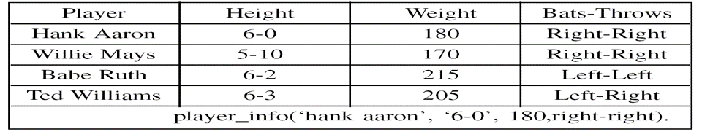
Simple Relational Knowledge
Simple Relational Knowledge
82

Slide 11
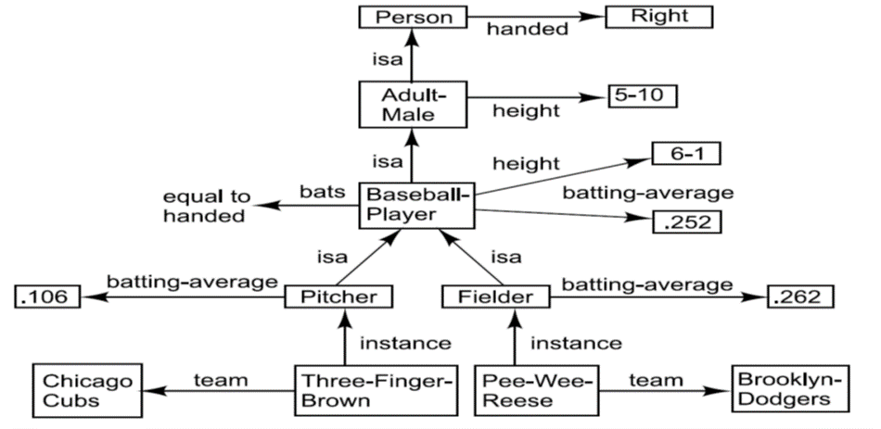
Inheritable Knowledge
Inheritable Knowledge
83

Slide 12
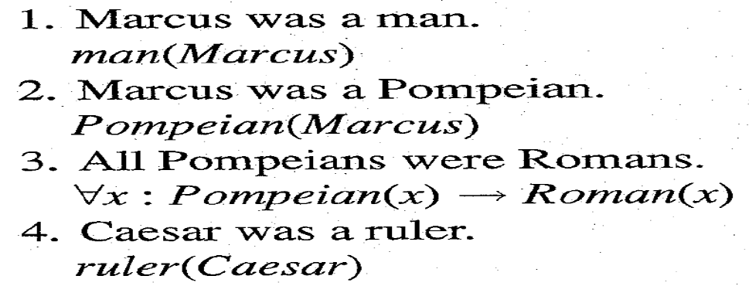
Knowledge Representation
Inferential Knowledge
  Sometimes all the power of traditional logic is necessary to describe he inferences that are needed.We can represent inferential knowledge about a domain using first order predicate-logic.
  But all this knowledge is useless unless there is also an inference procedure that can exploit it. The required inference procedure now is one that implements the standard logical rules of inference.
  There are many procedures, some of which reason forward from given facts to conclusions, some reason backward from desired conclusions to given facts. One most common procedure is RESOLUTION, which uses contradiction strategy.

Slide 13
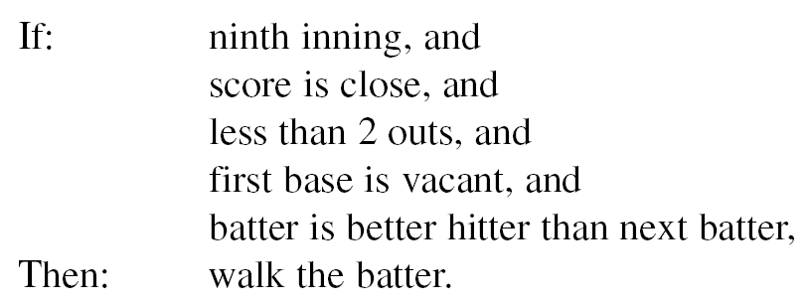
Knowledge Representation
Procedural Knowledge
  The previous forms deal with Static, Declarative facts. This knowledge specifies what to do and when.
  This knowledge can be represented in programs in many ways. The most common way is simply as code for doing something.
  The machine uses the knowledge when it executes the code to perform a task.
  Eg : If – then else etc.

Slide 14
Procedural knowledge as Rules
Procedural Knowledge as a Rules
88

Slide 15
Issues in knowledge representation
Issues in Knowledge Representation
→ Are there any basic attributes of objects?
→ Are there any basic relationships among objects?
→ At what level should knowledge be represented?
→ How should sets be represented?
→ How should knowledge be accessed?
89

Slide 16
Issues
1. Important Attributes
There are two attributes that are of very general significance(instance, isa) . These attributes are very important because they support property inheritance.
2. Relationship among attributes
Inverses
Existence in an isa hierarchy: generalization- specialization relationship are important for attributes as they are important for other concepts(eg: height;physical size; physical)

Slide 17
Techniques for reasoning about values:
Info about type of value (height is in number measured in unit of length)
Constraints on the value(age of child is not greater than age of parent)
Rules for computing the value when it is needed
Single valued attributes: that take only a unique value.( baseball player at any one time , have only single height and be member of only one team)
If some different value is asserted , then one of the two things happen:
Either a change has occurred in world or there is now a contradiction in knowledge base

Slide 18
Knowledge Representation
Simple Relational Knowledge
Player | Height | Weight | Runs
Dhoni | 6-0 | 150 | 3000
Sachin | 5-4 | 140 | 15000
Zaheer | 6-2 | 160 | 1000
This even does not tell us that who is the heaviest player?
A procedure should be defined to figure out the result.

Slide 19
Choosing granularity of representation
At what level of detail should the knowledge is represented?

Slide 20

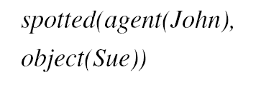

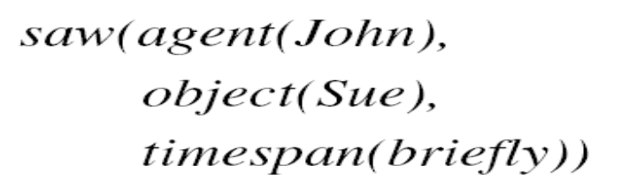
he Granularity of the RepresentationChoosi
Suppose we are interested in the following fact :
We could represent this as
Questions :
Who spotted Sue?
Did John see Sue?
We could add facts, e.g.:
An alternative representation:
91

Slide 21
Algorithm : Property Inheritance
To retrieve a value V for attribute A of an instance object O:
1. Find O in the knowledge base.
2. If there is a value there for the attribute A, report that value.
3. Otherwise, see if there is a value for the attribute instance. If not, then fail.
4. Otherwise, move to the node corresponding to that value and look for a value for the attribute A. If one is found, report it.
5. Otherwise, do until there is no value for the is a attribute or until an answer is found:
Get the value of the is a attribute and move to that node.
(b) See if there is a value for the attribute A. If there is, report it.
85

Slide 22
Thank You!!!

